Slide 1


SUBJECT-WISE DOUBT mANAGEMENT SYSTEM
DBMS PROJECT:
GRoup No. 17
INAAYA kHAN Roll no.44
Aman SIngh Roll no.65
Anmol goyal Roll no.66

Slide 2
Flow of Presentation
Introduction
Literature Survey
Problem Statement
Design
Software Used
Structure
Implementation
Features
Conclusion

Slide 3


Introduction
With so many different social media applications being used for the purpose of education at this time of quarantine, there is a clear need of a dedicated application for student and teachers to communicate.
This application can be used for doubts, discussions and announcements in an organized manner.
All student, teacher and learning data will be managed systematically.

Slide 4
Literature Survey
Sr. No. | Title of the paper | Authors of the paper | Description | Gaps identified
1 | Using the Facebook group as a learning management system: An exploratory study (2011) | Qiyun Wang Huay Lit Woo Choon Lang Quek Yuqin Yang Mei Liu | Facebook groups used to make communication easier for students and teachers while keeping information organized | Especially, with the recent updates, Facebook poses privacy risks to its users. The environment in itself is very unprofessional as it is not optimized for LMS
2 | “WhatsApp, Teacher?” - Student Perspectives on Teacher-Student WhatsApp Interactions in Secondary Schools (2018) | Hananel Rosenberg Christa S. C. Asterhan | Student's views on Whatsapp groups being used as a Learning Tool for information sharing. | As this application is majorly used as a personal daily messenger by many, it cannot be used as specialized application for education. And the data is generally very unorganized and hard to manage
3 | Determination of Student Opinions on Usage of Social Media and Mobile Tools in Student-Teacher, Student-Student Communication (2019) | Hasan Denizalp Fezile Ozdamli | The advantages of using various social media applications for Teacher Student Communication | Having educational content spread out across so many different platforms causes confusion. It is better to have one dedicated application specifically for education.

Slide 5

Problem Statement
With current social media applications being used for online learning in quarantine, a lot important data is unorganized and the application environment is generally found to be chaotic. With the data not being handled in an organized manner, there is a lot of confusion that needs to be sorted.
A new learning management system must be created

Slide 6
Who?
For the students and teachers of TCET.
What?
Learning management System
Where?
Online website
Why
To make Online Learning easier and more organized

Slide 7
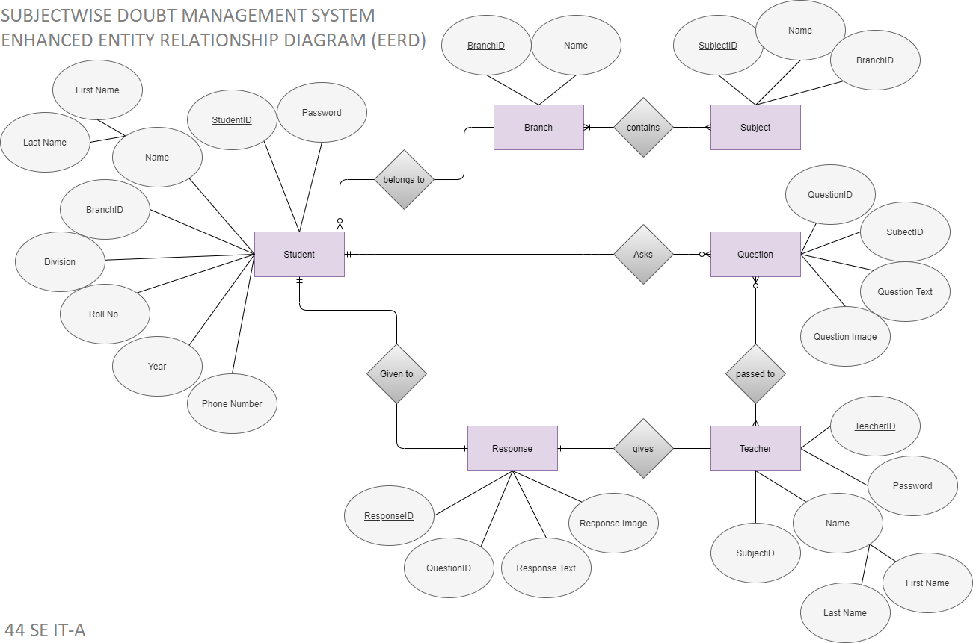

Design

Slide 8


SOFTWARE USED
Server: XAMPP
Editor: Visual Studio Code

Slide 9




Front End
HTML
CSS
Back End
SQL
PHP

Slide 10
Simple Structure
Student
Access
Respective
Subject Classes
Register
Teacher

Slide 11
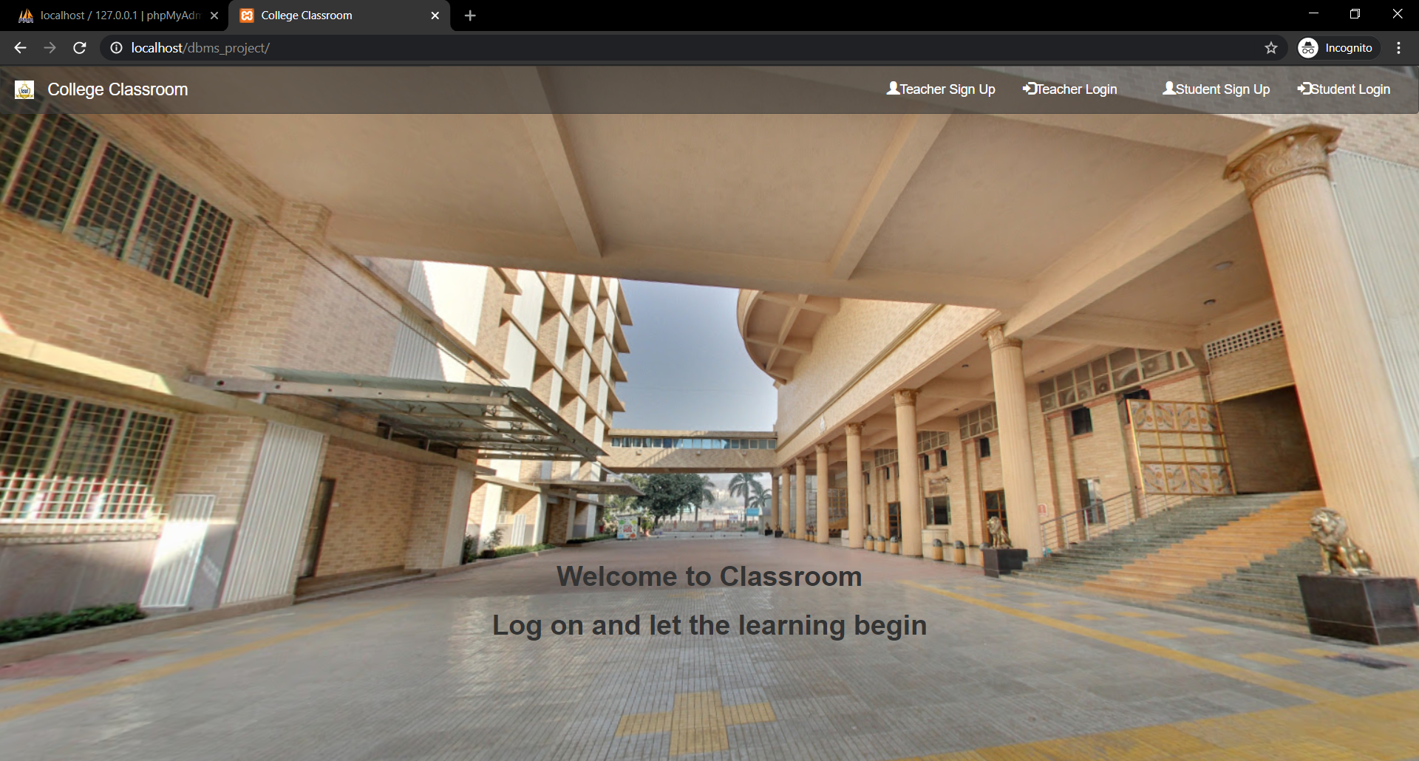
IMPLEMENTATIOn (Front-END)

Slide 12
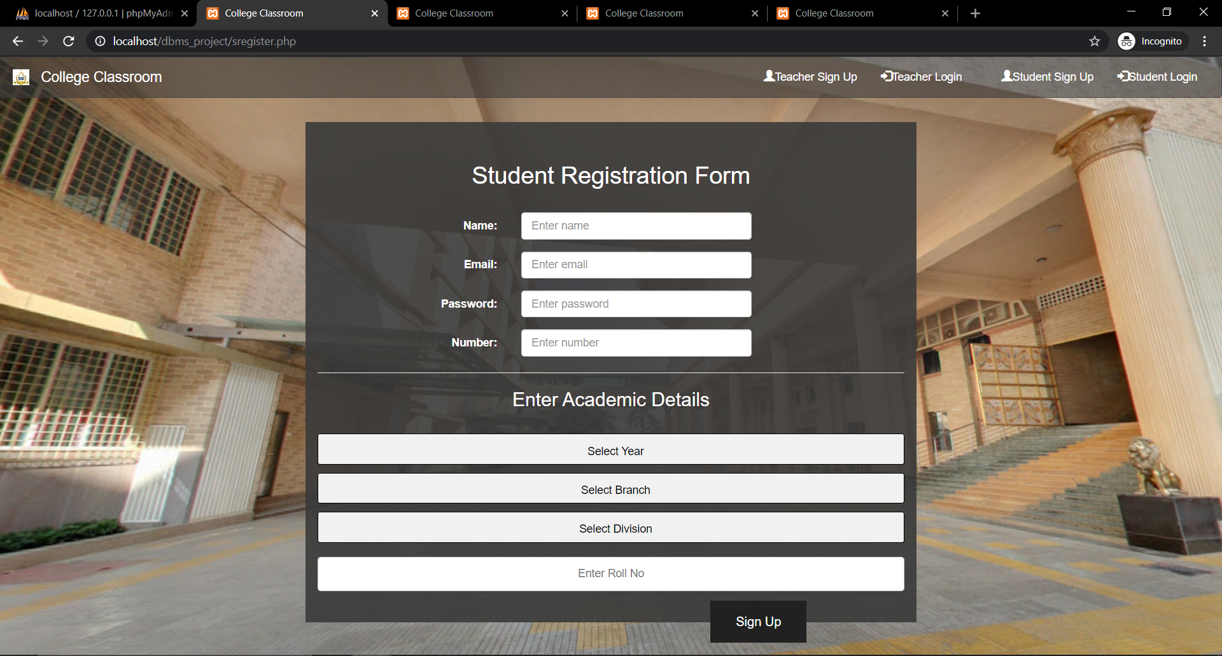
IMPLEMENTATIOn (front-end)

Slide 13
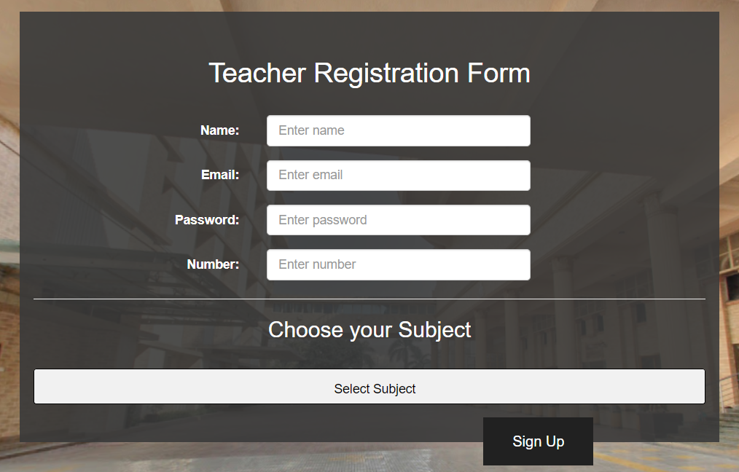
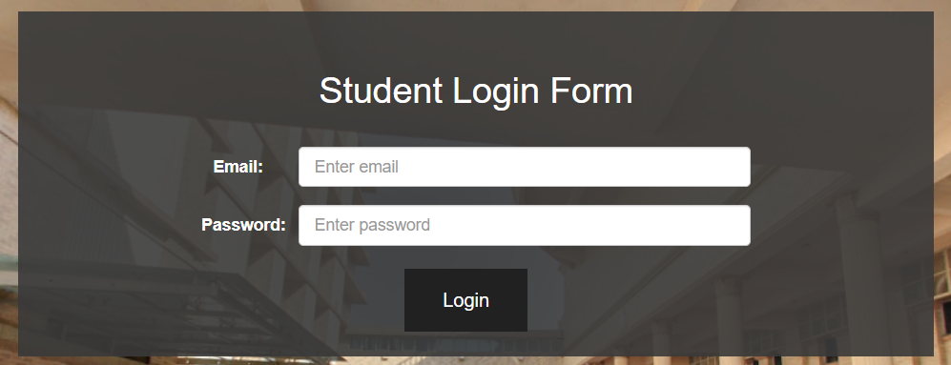
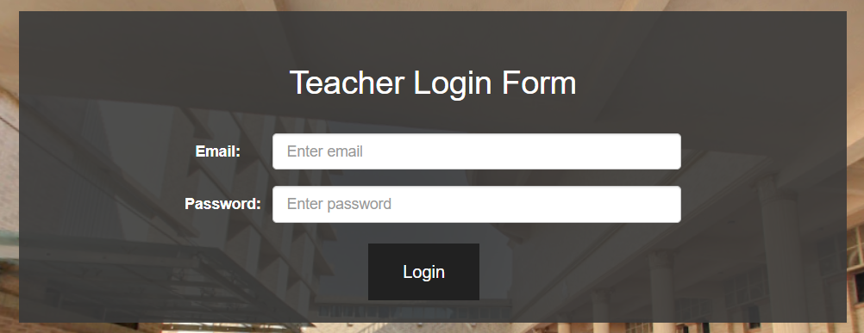
IMPLEMENTATIOn (front-end)

Slide 14
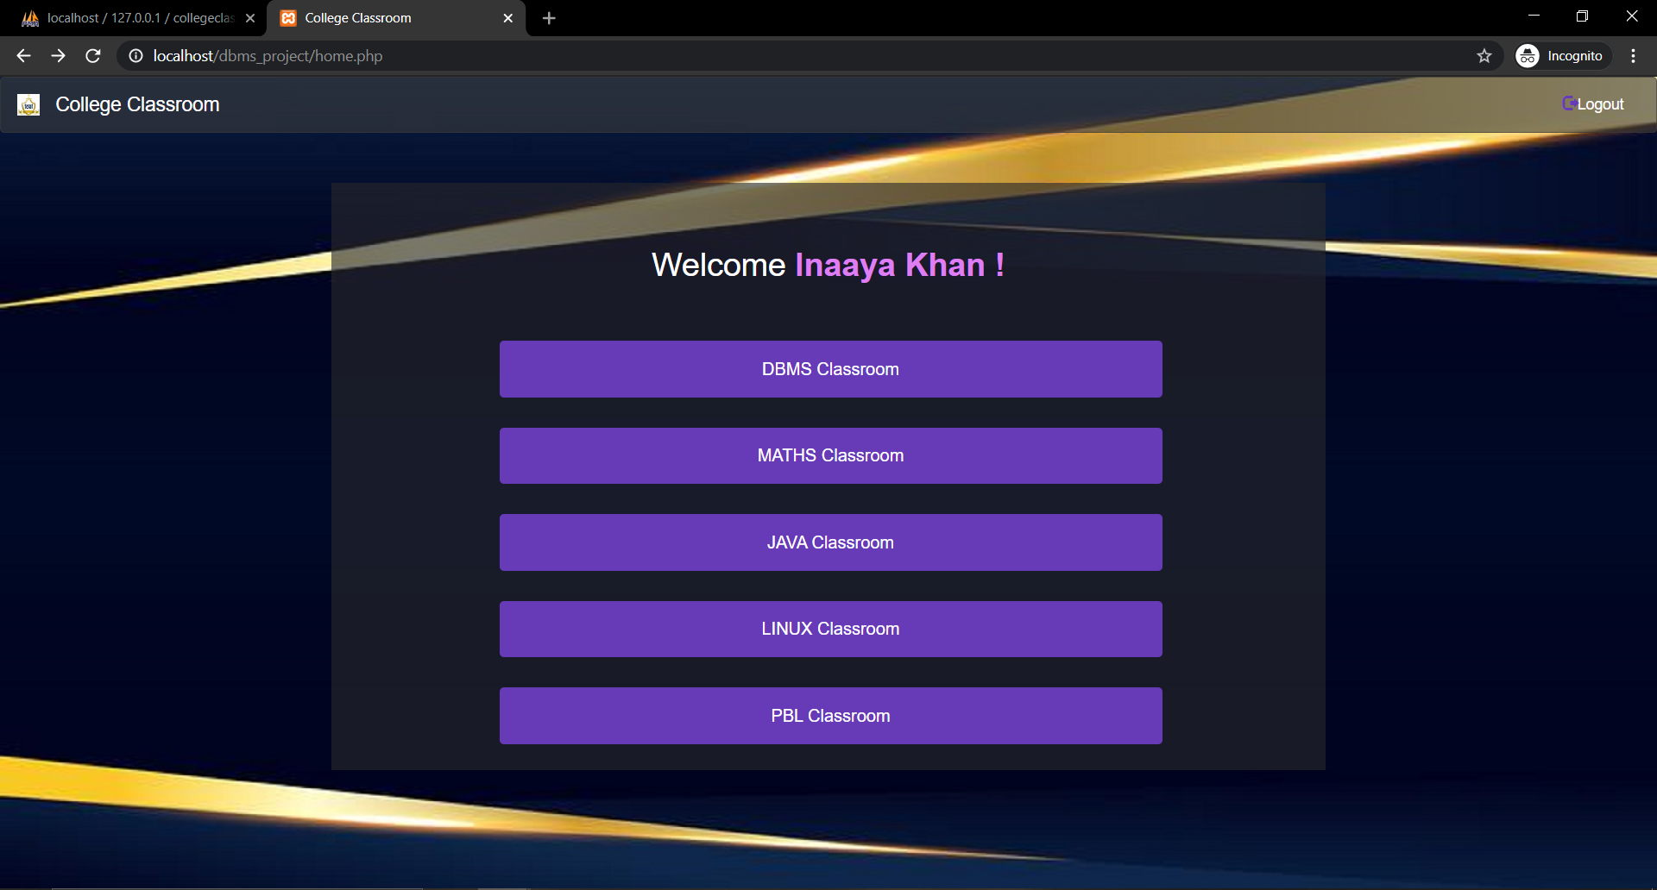
IMPLEMENTATIOn (front-end)

Slide 15
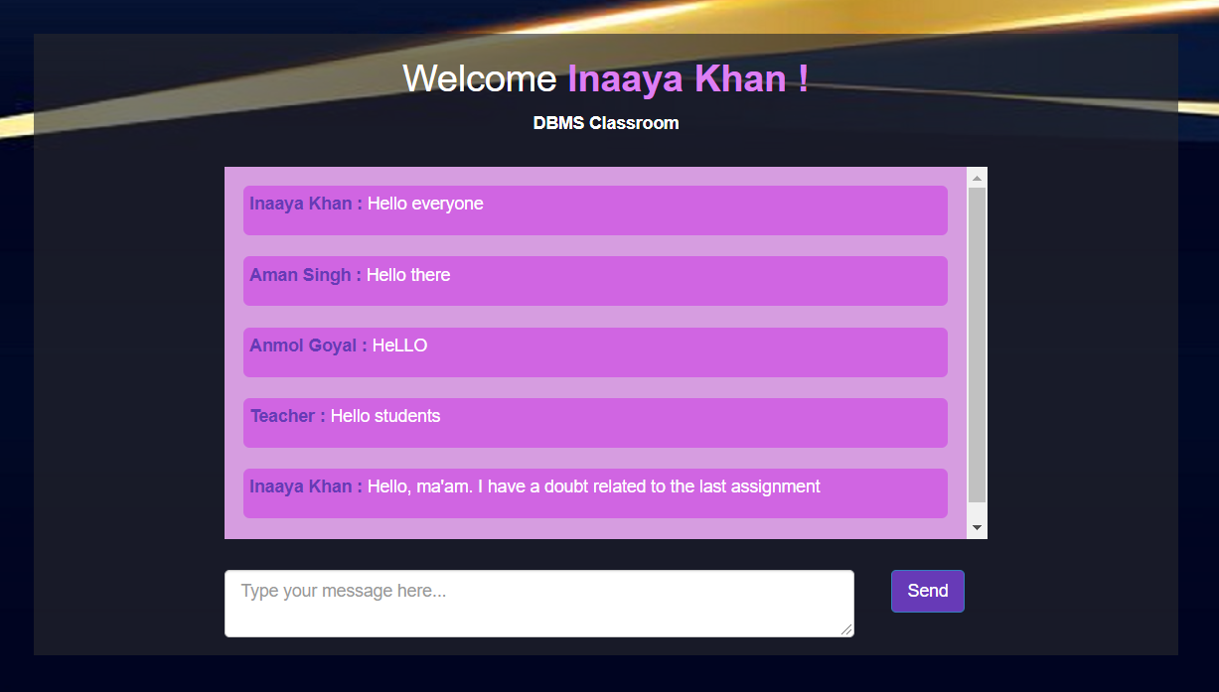
IMPLEMENTATIOn (front-end)

Slide 16


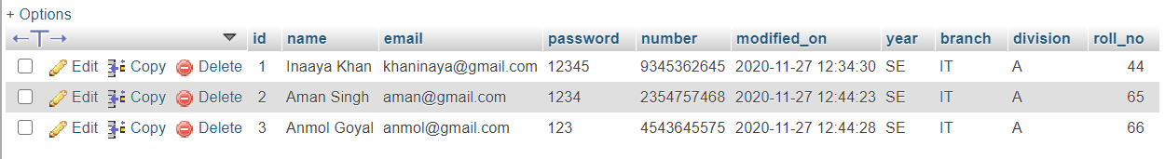
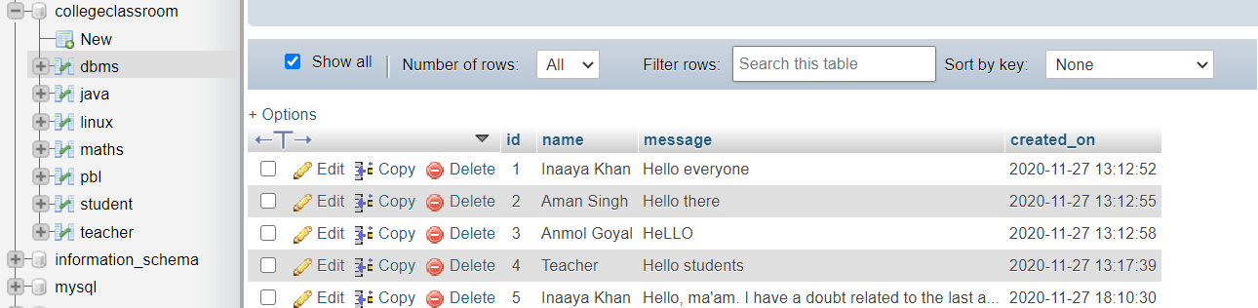
IMPLEMENTATIOn (BACK-end)

Slide 17

FEATURES
Replaces traditional grocery shopping
Safe
Organized
Convenient
User-friendly
Easy-to-use
Future improvements
Online Payment option
Free delivery
Advanced search with filters

Slide 18
Conclusion
Social media applications are ineffective for sharing and discussing educational content as they're simply not made for it.
It is better to have an application dedicated to the sole purpose of keeping all the learning organized.
Thus, we successfully built this simple Learning Management System using MySQL database and PHP data input and retrieval techniques for an interactive website designed using HTML and CSS.

Slide 19
References
Learning Management System Technologies and Software Solutions for Online Teaching: Tools and Applications by Kats, Yefim
https://books.google.co.in/books?id=2OsPGIvgjGwC&printsec=frontcover#v=onepage&q&f=false
Using the Facebook group as a learning management system: An exploratory study
British Journal of Educational Technology
Qiyun Wang Huay Lit Woo Choon Lang Quek Yuqin Yang Mei Liu
https://bera-journals.onlinelibrary.wiley.com/doi/abs/10.1111/j.1467-8535.2011.01195.x
“WhatsApp, Teacher?” - Student Perspectives on Teacher-Student WhatsApp Interactions in Secondary Schools
Journal of Information Technology Education: Research
Hananel Rosenberg, Christa S. C. Asterhan
https://www.informingscience.org/Publications/4081?Type=conferenceproceedings&ConferenceID=47
Determination of Student Opinions on Usage of Social Media and Mobile Tools in Student-Teacher, Student-Student Communication
International Journal of Emerging Technologies in Learning (iJET)
Hasan Denizalp, Fezile Ozdamli
https://onlinejour.journals.publicknowledgeproject.org/index.php/i-jet/article/view/11745

Slide 20
Thank YOU!

